Slide 1
Phishing detection using machine learning
Jaafar Bin Farooq 18k-1294
Zeerak Ibrahim 18k-1197
Wusatullah Nizamani 18k-1263

Slide 2
Web Phishing Detection
Phishing attack is used to steal confidential information of a user. Fraud websites appears like genuine websites with the logo and graphics of genuine website. This project aims to detect fraud or phishing website using machine learning techniques.

Slide 3
Objective
The objective of this project is to train machine learning models on the dataset created to predict phishing websites.
The dataset contains website content-based features of the phishing and legitimate websites.
The performance level of each model is measures and compared.

Slide 4
Data Selection
The dataset is downloaded from UCI machine learning repository. A collection of website URLs for 11000 websites. Each sample has 30 website parameters and a class label identifying it as a phishing website or not (1 or -1).
Legitimate websites: 4898
Phishing Websites: 6157

Slide 5
Feature Selection and Data preprocessing
having_IP_Address { -1,1 }
URL_Length { 1,0,-1 }
Shortining_Service { 1,-1 }
having_At_Symbol { 1,-1 }
double_slash_redirecting { -1,1 }
Prefix_Suffix { -1,1 }
having_Sub_Domain { -1,0,1 }
SSLfinal_State { -1,1,0 }
Domain_registeration_length { -1,1 }
Favicon { 1,-1 }
port { 1,-1 }
HTTPS_token { -1,1 }
Request_URL { 1,-1 }
URL_of_Anchor { -1,0,1 }
Links_in_tags { 1,-1,0 }
SFH { -1,1,0 }
Submitting_to_email { -1,1 }
Abnormal_URL { -1,1 }
Redirect { 0,1 }
on_mouseover { 1,-1 }
RightClick { 1,-1 }
popUpWidnow { 1,-1 }
Iframe { 1,-1 }
age_of_domain { -1,1 }
DNSRecord { -1,1 }
web_traffic { -1,0,1 }
Page_Rank { -1,1 }
Google_Index { 1,-1 }
Links_pointing_to_page { 1,0,-1 }
Statistical_report { -1,1 }
Result { -1,1 }
Null values in selected features were dropped
There were a total of 30 features.
Features which were more related to the Result were selected
Correlation of each feature with result was calculated
Features with correlation between -0.02 to 0.02 were dropped.
Total Features used : 24
Features dropped: 6 ['Iframe','Favicon','popUpWidnow','index','RightClick','Submitting_to_email’]

Slide 6
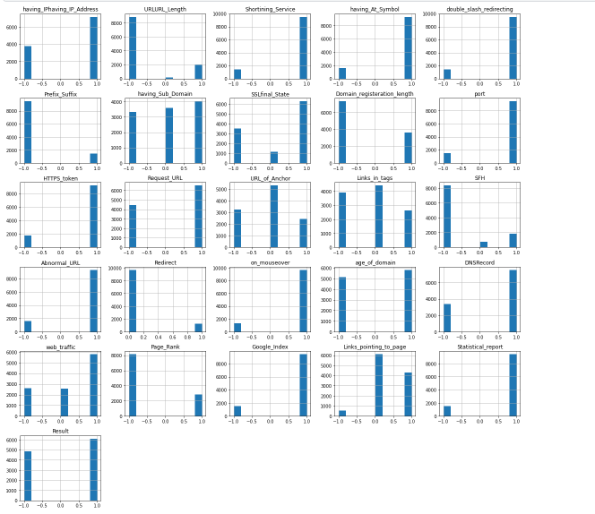
Feature Distribution

Slide 7
Data distribution for training and testing
Dataset is split in 80:20 ratio
80 % for training
20% for testing

Slide 8
Machine learning Models
This data set comes under classification problem, as the input URL is classified as phishing (1) or legitimate (-1). The machine learning models (classification) considered to train the dataset in this notebook are :
Decision tree
Random Forest
K Nearest Neighbor
SVM
XLGBoost

Slide 9
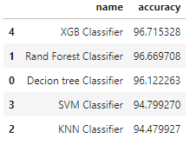
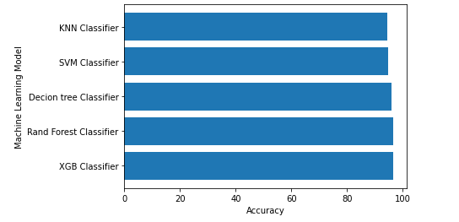
Machine Learning Models Evaluation
The models are evaluated, and the considered metric is accuracy.
Below Figure shows the test dataset accuracy by the respective models:
For the above it is clear that the XGBoost model gives better performance, KNN model gives the worst performance.

